Slide 1
VUV and EUV irradiation of CH₄ + NH₃ ice mixtures
Lily Leung

Slide 2
Contents
Introduction
Deposition rate of methane on Charon
Surface temperatures at different latitudes
Ammonia on Organa Crater
Production mechanism of CN⁻
Methodology
Experimental setup
The spectrum of VUV (MDHL) energy source
Experimental Configurations
Results
Production of CN⁻
The relations between CN⁻ and C₂H₆
CN⁻ formation efficiency of EUV (40.1 eV) and VUV (9.27 eV)
Astrophysical Implications
Understand CN⁻ formation after winter on surface of Charon

Slide 3
Introduction

Slide 4
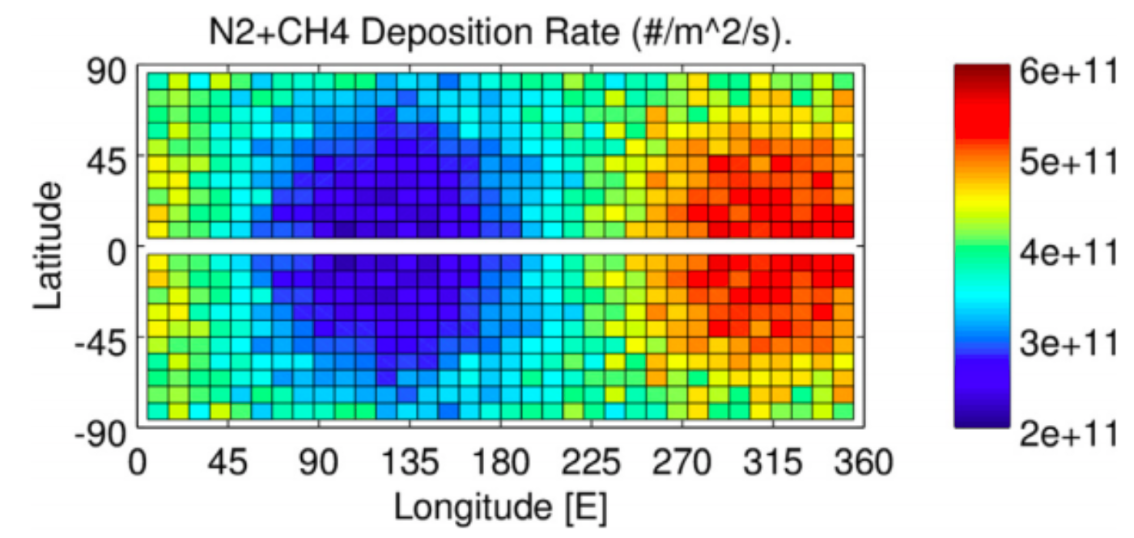
Deposition rate of methane on Charon
quoted from Hoey et al. (2017)

Slide 5
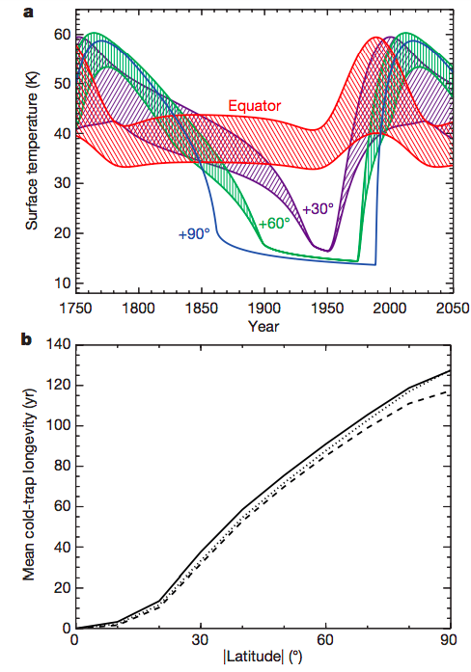
Surface temperatures
at different latitudes
Thermal model from Grundy et al. (2016) shows the pole position is below 25 K for 130 years
Methane can condense on those positions where the temperature is below 25 K.
Quoted from Grundy et al. (2016)

Slide 6
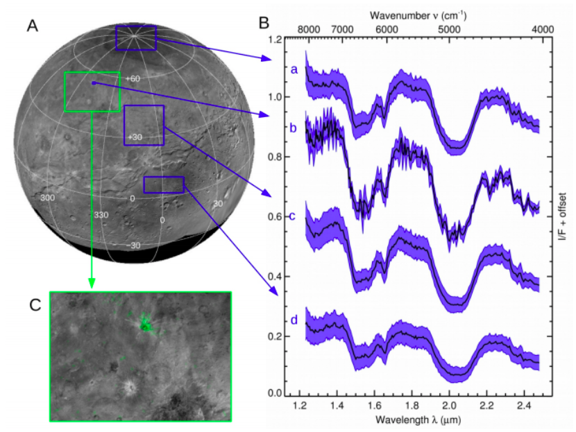
Ammonia on Organa Crater
Ammonia was detected all over the surfaces, especially on Organa Crater
from Grundy et al. (2016)

Slide 7
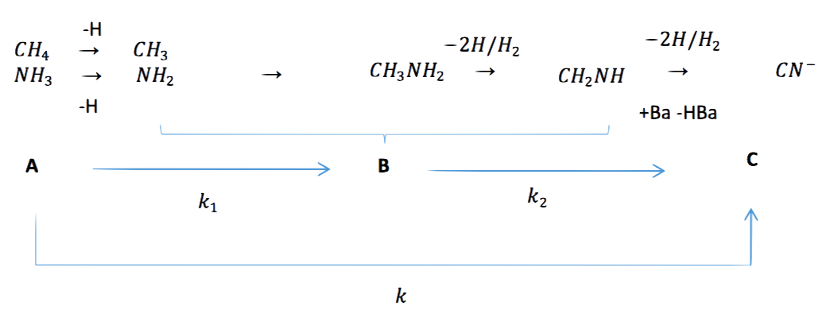
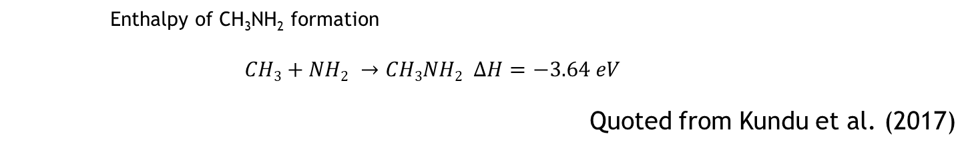
Production mechanism of CN⁻
Enthalpy of CH₃NH₂ formation
$$CH3+NH2 →CH3NH2 ∆H=−3.64 eV$$
Quoted from Kundu et al. (2017)
Quoted from Kim and Kaiser (2011)

Slide 8
Production mechanism of CN⁻
Attempts to detect CH₃NH₂:
Different results from 2 e⁻ irradiating experiments
5 keV e⁻ by Kim and Kaiser (2011):
The intermediate CH₃NH₂ was detected by TPD
1- 90 eV e⁻ experiment by Kundu et al.(2017)
The intermediate CH₃NH₂ cannot be detected by TPD
How about photons?

Slide 9
Methodology

Slide 10
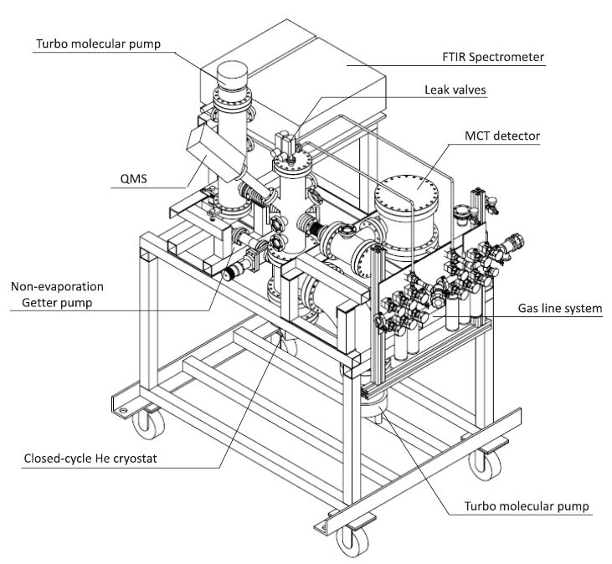
Experimental setup
IR path
VUV/EUV path
Quoted from Chen et al. (2014)

Slide 11
Experimental Protocol
Infra-red
KBr substrate is pre-cooled to 15 K (1 x 10 ⁻¹⁰ torr) from 300 K ( 8 x 10 ⁻¹⁰ torr)
QMS
Deposit the ice mixtures through leak valve, with different partial pressures of CH₄ and NH₃
EUV/VUV
Irradiate the samples by EUV/VUV
KBr substrate
Warm-up with 1 K/min

Slide 12
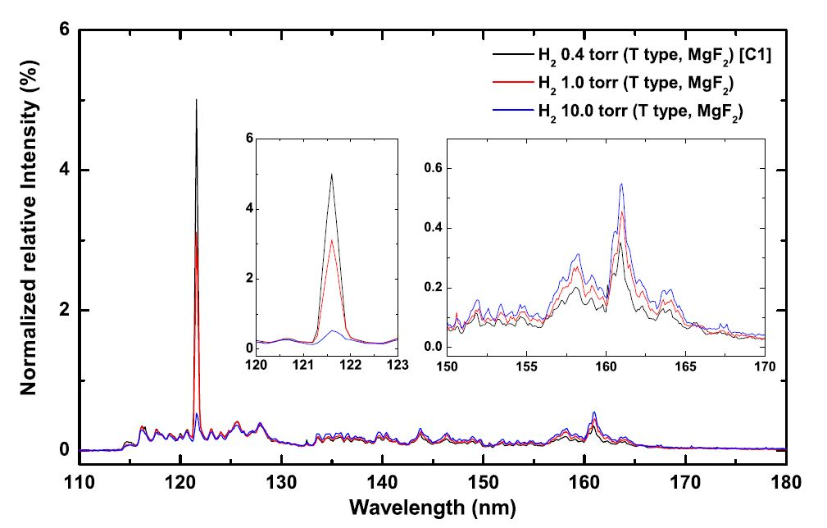
The spectrum of VUV (MDHL) energy source
H₂ 0.4 torr was adopted
19.1% is Ly-α
average photon energy 9.27 eV
Quoted from Chen et al. (2014)

Slide 13
Experimental Configurations
Energetic Source | constituent | Column Density of CH₄+NH₃ ice mixtures (x10 ¹⁵ molecules cm⁻²)
 |  | 3:2 | 1:5 | 1:10 | 1:20
VUV (MDHL) | CH₄ | 900 | 120 | 60 | 30
 | NH₃ | 600 | 600 | 600 | 600
EUV (30.4 nm) | CH₄ | 900 | 120 | -- | --
 | NH₃ | 600 | 600 | -- | --

Slide 14
Results

Slide 15
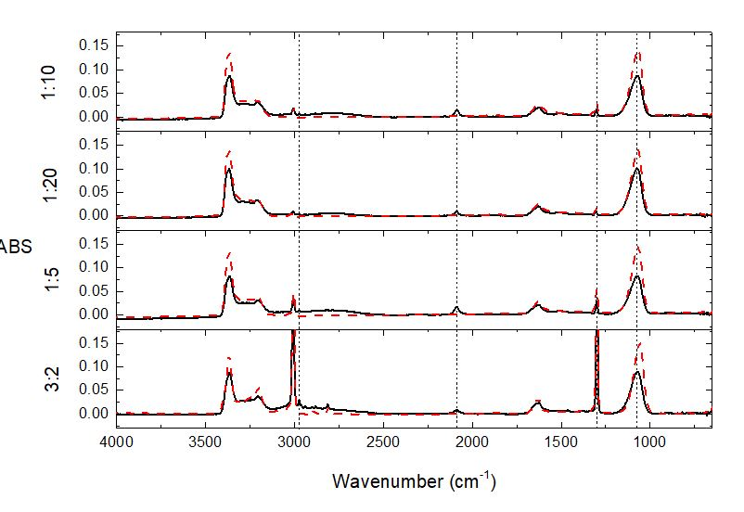
Infra-red spectra
Infra-red spectra before (red dotted lines) and after (solid lines) VUV irradiation
CN⁻ C₂H₆ and C₃H₈ are formed after VUV irradiation
C₂H₆
CN⁻
CH₄
NH₃

Slide 16
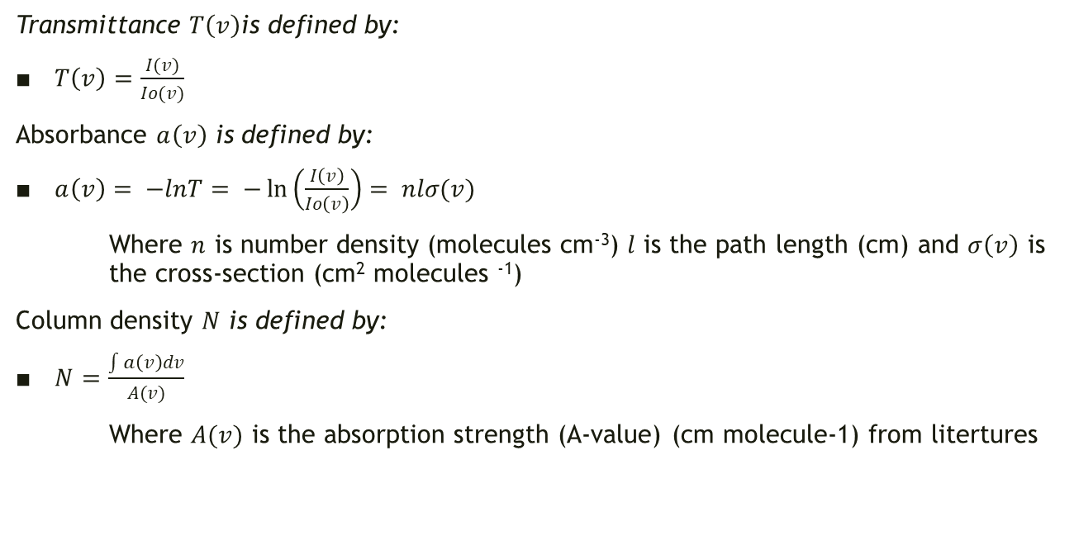
From Beer’s Law
Transmittance $T\left(v\right)$is defined by:
$T\left(v\right)=\frac{I(v)}{Io(v)}$
Absorbance $a\left(v\right)$ is defined by:
$a\left(v\right)= −lnT= −\ln\left(\frac{I\left(v\right)}{Io\left(v\right)}\right)= nlσ(v)$
Where $n$ is number density (molecules cm⁻³) $l$ is the path length (cm) and $σ\left(v\right)$ is the cross-section (cm² molecules ⁻¹)
Column density $N$ is defined by:
$N=\frac{\int{a\left(v\right)dv}}{A(v)}$
Where $A(v)$ is the absorption strength (A-value) (cm molecule-1) from litertures

Slide 17
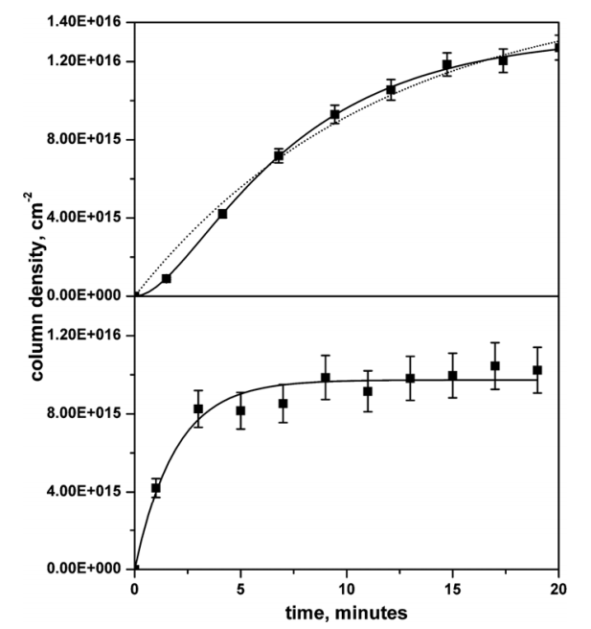

1. Production of CN⁻
2 step/1 step?
2 step rate equation:
$\left[{CN}^{−}\right]=\left(1+\frac{{k_{1}e}^{−k_{2}t}−{k_{2}e}^{−k_{1}t}}{k_{2}−k_{1}}\right){[A]}_{o}$
1 step rate equation:
$\left[{CN}^{−}\right]=\left(1+e^{−kt}\right){[A]}_{o}$
Quoted from Kim and Kaiser (2011)

Slide 18
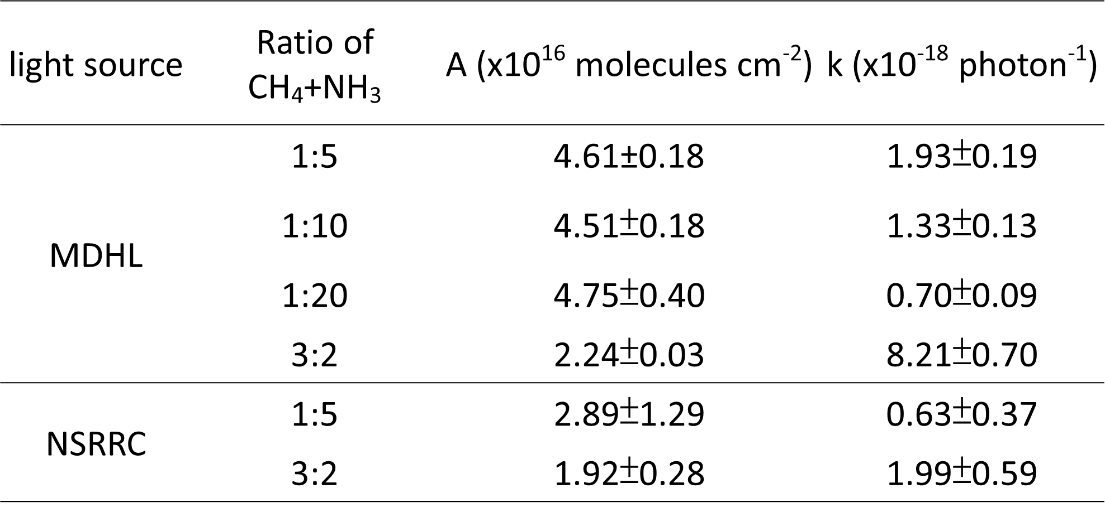
1. Production of CN⁻
2 step/1 step?

Slide 19
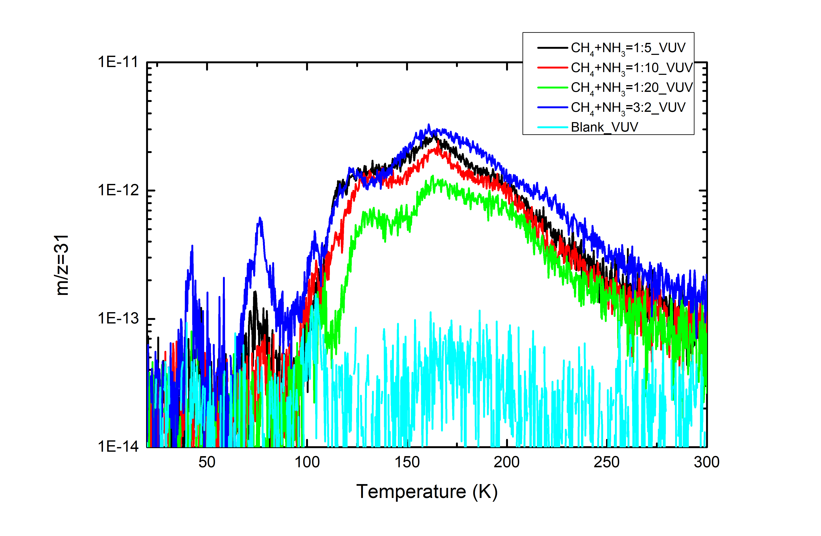
1. Production of CN⁻
Methylamine (CH₃NH₂) with m/z=31 is detected by QMS after isothermal VUV irradiation during warm-up which is the intermediate of the CN⁻

Slide 20
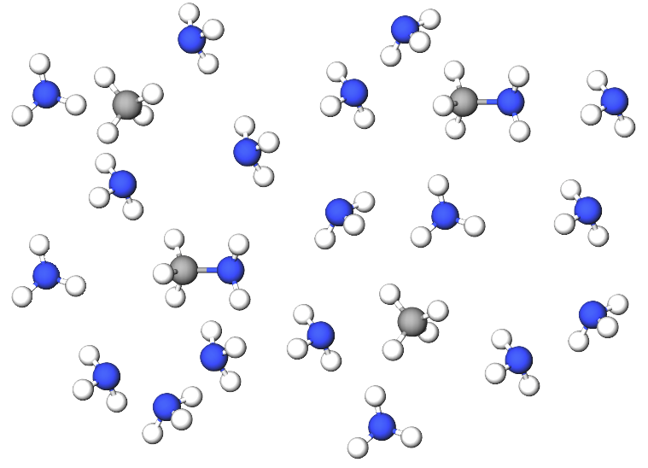
2. The scenario for NH₃ dominating ice mixtures
CH₄
NH₃
NH₂ (forming CH₃NH₂) has a competing relationship with CH₂ CH₃ and C₂H₄ (forming C₂H₆ and C₃H₈)
Once CH₄ becomes CH₃ radical, it can easily forms methylamine and hence become CN⁻.
A diagram of CH₄+NH₃ = 1:5

Slide 21
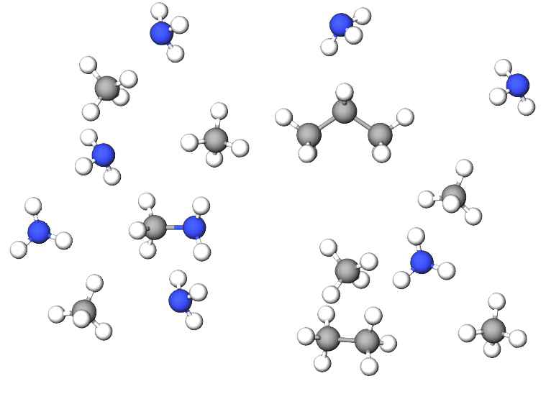
2. The scenario for CH₄ dominating ice mixtures
NH₂ (forming CH₃NH₂) has a competing relationship with CH₂ CH₃ and C₂H₄ (forming C₂H₆ and C₃H₈)
Once CH₄ becomes CH₃ radical, it reacts with either NH₂ or CH₃ radicals, forming CH₃NH₂, C₂H₆ and C₃H₈
A diagram of CH₄+NH₃ = 3:2

Slide 22
2. The relations between CN⁻ and C₂H₆ during VUV irradiations
Ratio of CH₄+NH₃ | C₂H₆ (ML) | CN⁻ (ML)
3:2 | 19.1 | 23
1:5 | 4.3 | 49

Slide 23
3. Efficiency of EUV (40.1 eV) and VUV (9.27 eV)
Radicals species | CH₄ | NH₃
- 1 H | 4.55 eV | 4.67 eV
-2 H | 4.78 eV | 4.38 eV
-3 H | 9.19 eV | 7.63 eV
(quoted from Kundu et al. (2017))

Slide 24
3. CN⁻ formation efficiency of EUV (40.1 eV) and VUV (9.27 eV)
Fitting with y = Ae^{-kx} + C (pseudo first order kinetics)
CH₄ NH₃

Slide 25
3. CN⁻ formation efficiency of EUV (40.1 eV) and VUV (9.27 eV)
k (photons ⁻¹) | CH₄(x 10⁻¹⁸) | NH₃ (x10⁻¹⁸)
VUV (MDHL) | 3.70±0.18 | 2.89±0.10
EUV (30.4nm) | 0.61±0.03 | 0.91±0.11
Destruction cross-section ratio | 6.06±0.07 | 3.18±0.12
k (photon ⁻¹) | CH₄ to NH₃ 3:2 (x 10⁻¹⁸) | CH₄ to NH₃ 1:5 (x10⁻¹⁸)
VUV (MDHL) | 8.21±0.70 | 1.93±0.19
EUV (30.4nm) | 1.92±1.99 | 0.63±0.37
CN- production ratio | 4.28 | 3.06

Slide 26
Astrophysical implications

Slide 27
Astrophysical implications
Ly α is the main energy source to produce CN⁻ on Charon
3.06 to 4.28 times more efficient by VUV then EUV
VUV flux is 1 order of magnitude more intense than EUV irradiations (Grundy et al. 2016)
Ly α exposure: 1.9 x 10⁹ eV cm⁻² s⁻¹
EUV exposure: 8.7 x 10⁷ eV cm⁻² s⁻¹

Slide 28
Understand CN- formation after winter on surface of Charon
Surface composition after 1 Pluto winter:
Ly α exposure: 1.9 x 10⁹ eV cm⁻² s⁻¹ (Grundy et al. 2016)
= photon dose 7.64x 10 ¹⁷ photons cm⁻²
CH₄ deposition rate: 2-6 x 10⁷ cm⁻² s⁻¹ (Hoey et al. 2017
= 82-246 ML in 130 earth years
CH₄+NH₃ | CN⁻ (ML)
1:5 | 36.6
1:10 | 29.5
1:20 | 18.9
3:2 | 22.5

Slide 29
Conclusion
1. Detection of methylamine implies that in
2. Concentration of CN⁻ is not proportional to initial CH₄ when CH₄ is in excess.
3. The reduced destruction cross-section of EUV 30.4nm irradiation is the main factor of slowing the rate of formations.
4. The maximum amount of CN⁻ after Charon winter is simulated experimentally.

